Slide 1

Shootings In New York City
Luis Cerrilla, Arthur Edwards, Ahasan Hossain and Kyle Cielencki

Slide 2

Background
Our dataset is a list of every shooting incident in New York City going back to 2006 through the end of the previous calendar year (currently in 2019).
The dataset is from City of New York Open Data (“Open Data”).
The original City of New York data is manually extracted every quarter and reviewed by the Office of Management Analysis and Planning before being posted on the NYPD website. Each record represents an actual shooting incident in New York City and includes information about the event, the location and time of occurrence. Additionally, the information related to suspect and victim demographics is also included.
The data presented here, through our visualizations, is pulled from the Open Data API, visualized with JavaScript libraries (D3 and Plotly) and hosted on an HTML webpage with dynamic dashboards.

Slide 3
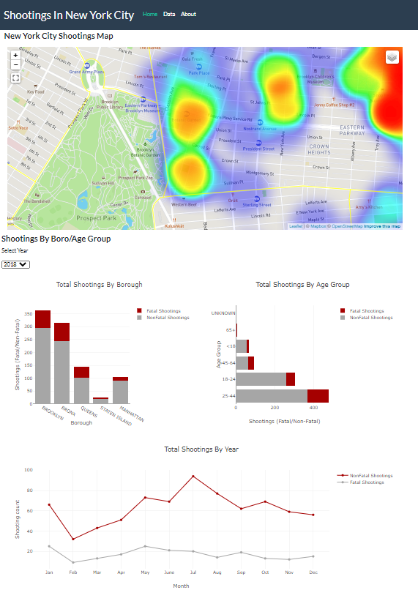
Overview: Home Tab
Our visualizations provide breakdowns of every shooting incident in the form of the following:
A map breaking out fatal/non-fatal shootings by sex. (top center)
This includes a heatmap of the concentrations of shootings in addition to a neighborhood map color-coded by Borough
Interactive vertical bar chart of shootings for each Borough (user can toggle between years). (below map, to left)
Interactive horizontal bar chart of shootings for each age group(user can toggle between years) .(below map, to right)
The line graph displays shooting count for non-fatal and fatal filtered through different years. (bottom center)

Slide 4
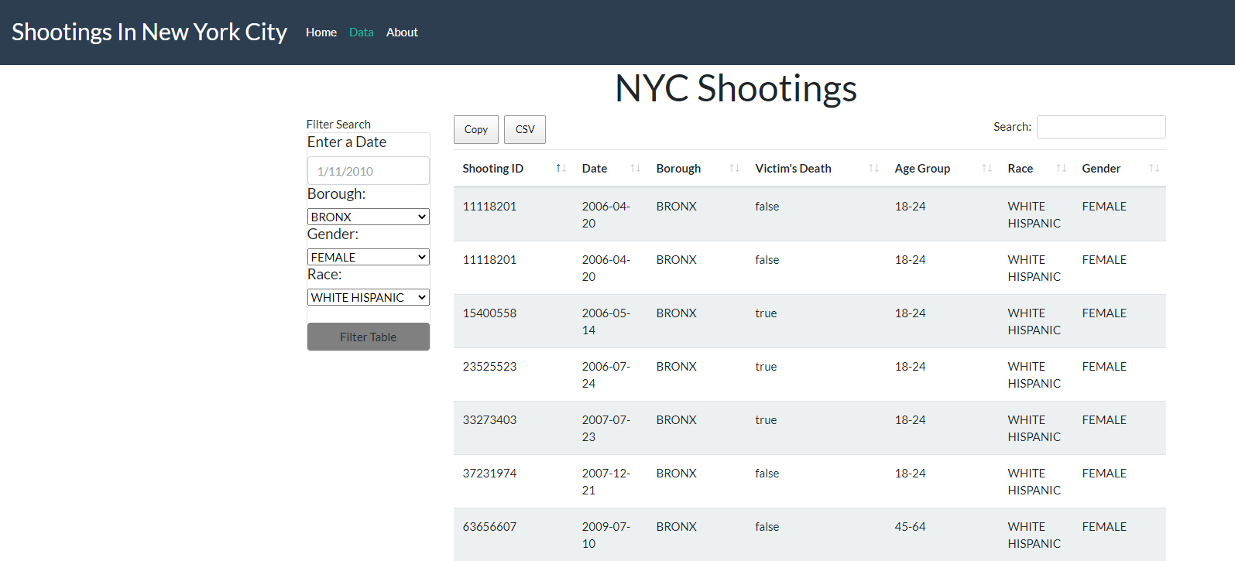
Overview: Data Tab
The Data tab provides the raw data in a Table format with search bar, drop-downs, filters and the ability to export to a CSV, in addition to copying the entire dataset.

Slide 5
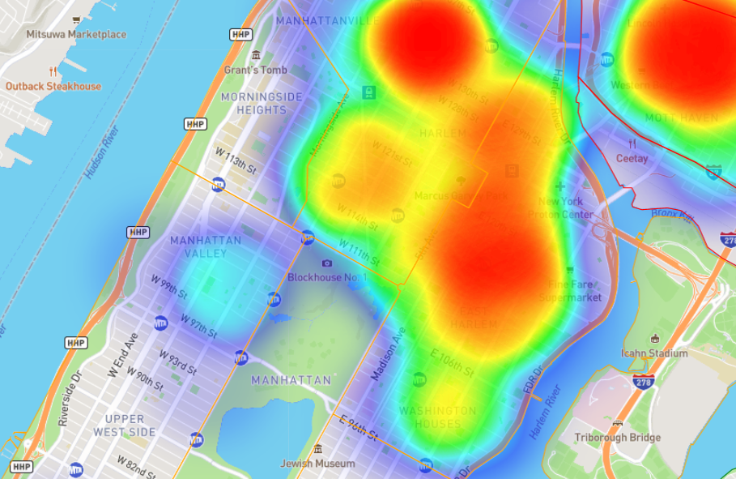
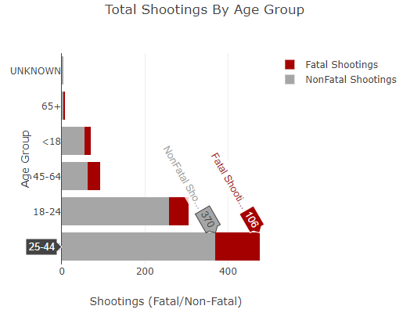
Findings
Shootings increase during the summer months (June-July)
Additionally, there is an increase in shootings in January
Shootings are mostly concentrated in Brooklyn and the Bronx
In other Boroughs, shootings follow distinct neighborhood lines:
In Manhattan, the dividing line between Harlem and the Upper West Side is 110th St. The dividing line between Harlem and the Upper East Side is 96th St.
In Queens, Jamaica has the highest concentration of shootings
The 24-44 and 18-24 year old age groups have the highest proportion of shootings

Slide 6
Issues/Hurdles
The primary issue we ran into was timing. Given this is a skill we’re developing, we were not the most efficient in putting together the site and visualizations.
Another issue we ran into was formatting:
Pulling the years from the date-time stamp and appending to the drop-down.
Changing filters from “True/False” on Victim Death to “Yes” or “No.”
Data quality issues:
Due to the timing of the data releases, there is a one-year lag in the data.
There were not full-year data for years 2007-2016
The age groups were not equally distributed
Additionally, it was difficult pulling everyone’s code together and applying it to a cohesive website with interactive visualizations.

Slide 7
Questions?

